Slide 1
Serverless on AWS
Pravin Y Pawar

Slide 2

Serverless on AWS
Build and run applications without thinking about servers
Serverless is a way to describe the services, practices, and strategies that enables building more agile applications
to foster innovations and responses to the changes faster
With serverless computing, infrastructure management tasks like capacity provisioning and patching are handled by AWS
developer can focus on only writing code that serves customers
Serverless services like AWS Lambda come with
automatic scaling
built-in high availability
and a pay-for-value billing model
Lambda is an event-driven compute service that enables to run code in response to events from over 150 natively-integrated AWS and SaaS sources
all without managing any servers

Slide 3
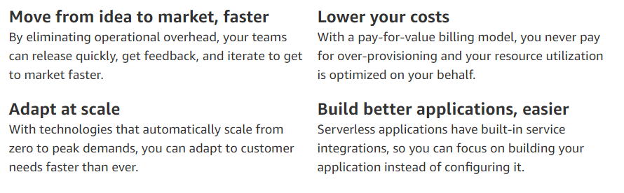
Benefits

Slide 4
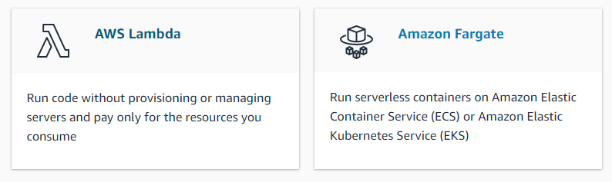
Serverless Services on AWS
Compute

Slide 5
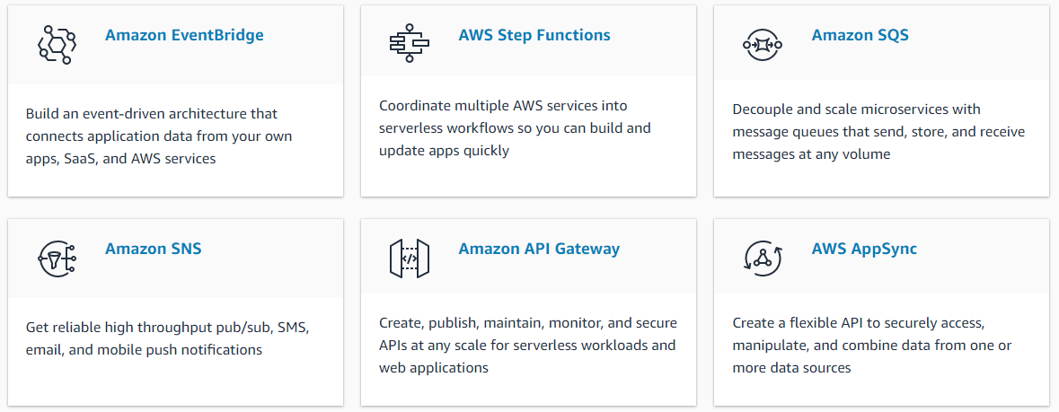
Serverless Services on AWS(2)
Application Integration

Slide 6
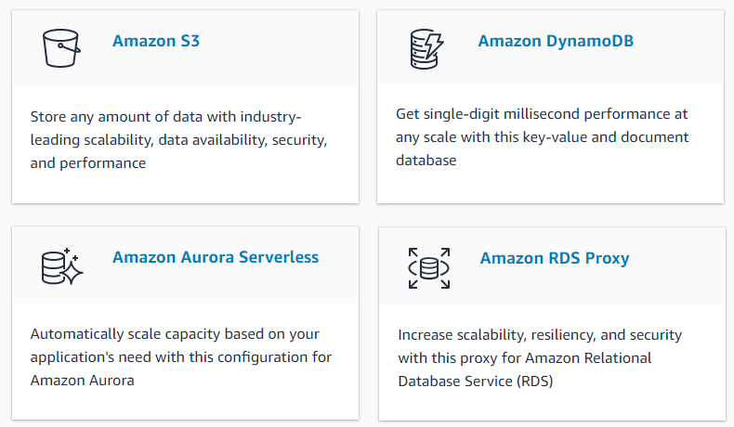
Serverless Services on AWS(3)
Data Store

Slide 7
Thank You!
Reference :
AWS Serverless
In our next session:

